Slide 1
SEVZI ZC467
Computer Networks
Contact Session – 3
Prabhu Subramanian

Slide 2

IMP Note to Self
Dr. Rama Satish K V, Visiting Professor, Wipro-WASE, Bengaluru

Slide 3
Important Note to Students
It is important to know that just login to the session does not guarantee the attendance.
Once you join the session, continue till the end to consider you as present in the class.
IMPORTANTLY, you need to make the class more interactive by responding to Professors queries in the session.
Whenever Professor calls your number / name, you need to respond, otherwise it will be considered as ABSENT
Dr. Rama Satish K V, Visiting Professor, Wipro-WASE, Bengaluru

Slide 4
Topics to Discuss
Application Layer
Email - Simple Mail Transfer Protocol
Domain Name Systems (DNS)
BITS Pilani, Deemed to be University under Section 3 of UGC Act, 1956

Slide 5
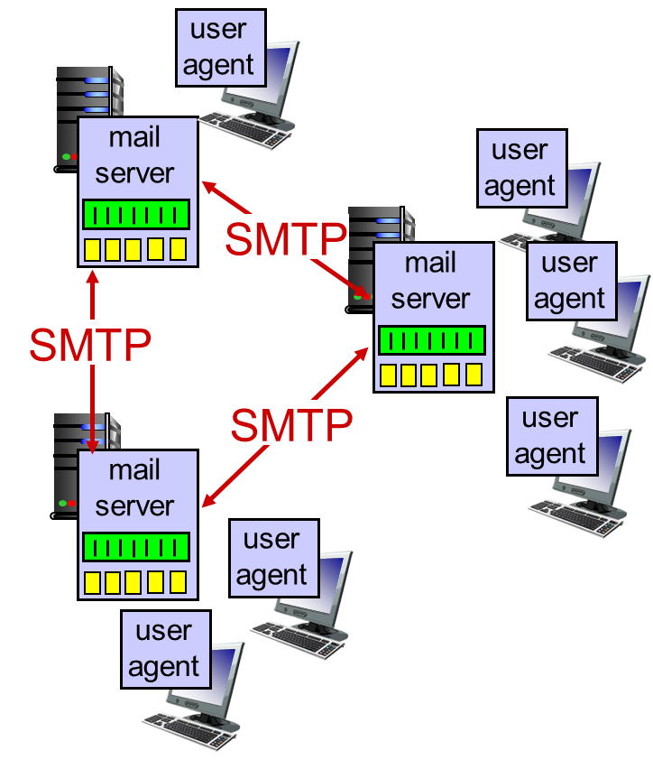
Email - Simple Mail Transfer Protocol
One of the most popular and utilized application in Internet.
Its architecture consists of several components
Three major components:
  User agents
    mail reader
    composing, editing, reading mail messages
  Mail servers
    mailbox contains incoming messages for user
    message queue of outgoing (to be sent) mail messages
  SMTP protocol between mail servers to send email messages
    client: sending mail server
    “server”: receiving mail server
BITS Pilani, Deemed to be University under Section 3 of UGC Act, 1956

Slide 6
Email - Simple Mail Transfer Protocol
Electronic Mail: Common scenario
When the sender and the receiver of an e-mail are on the same system,we need only two user agents.
When the sender and the receiver of an e-mail are on different systems, we need two UAs and a pair of MTAs (client and server).
When the sender is connected to the mail server via a LAN or a WAN, we need two UAs and two pairs of MTAs (client and server).
When both sender and receiver are connected to the mail server via a LAN or a WAN, we need two UAs, two pairs of MTAs and a pair of MAAs →This is the most common situation today.
BITS Pilani, Deemed to be University under Section 3 of UGC Act, 1956

Slide 7


Email - Simple Mail Transfer Protocol
Scenario-1: When the sender and the receiver of an e-mail are on the same system, we need only two user agents.
Scenario-2: When the sender and the receiver of an e-mail are on different systems, we need two UAs and a pair of MTAs (client and server).
BITS Pilani, Deemed to be University under Section 3 of UGC Act, 1956

Slide 8

Email - Simple Mail Transfer Protocol
Scenario-3: When the sender is connected to the mail server via a LAN or a WAN, we need two UAs and two pairs of MTAs (client and server).
BITS Pilani, Deemed to be University under Section 3 of UGC Act, 1956

Slide 9

Email - Simple Mail Transfer Protocol
Scenario-4: When both sender and receiver are connected to the mail server via a LAN or a WAN, we need two UAs, two pairs of MTAs and a pair of MAAs →This is the most common situation today.
BITS Pilani, Deemed to be University under Section 3 of UGC Act, 1956

Slide 10
Email - Simple Mail Transfer Protocol
Uses TCP to reliably transfer email message from client to server, port 25
Direct transfer: sending server to receiving server
Three phases of transfer
  handshaking (greeting)
  transfer of messages
  closure
Command/response interaction (like HTTP, FTP)
  commands: ASCII text
  response: status code and phrase
BITS Pilani, Deemed to be University under Section 3 of UGC Act, 1956

Slide 11
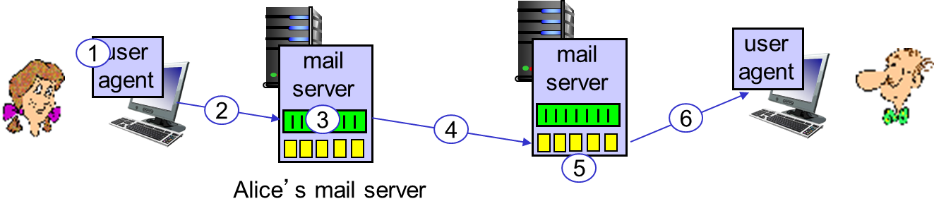
Scenario: Alice sends message to Bob
1) Alice uses UA to compose message “to” bob@someschool.edu
2) Alice’s UA sends message to her mail server; message placed in message queue
3) client side of SMTP opens TCP connection with Bob’s mail server
4) SMTP client sends Alice’s message over the TCP connection
5) Bob’s mail server places the message in Bob’s mailbox
6) Bob invokes his user agent to read message
Bob’s mail server
BITS Pilani, Deemed to be University under Section 3 of UGC Act, 1956

Slide 12
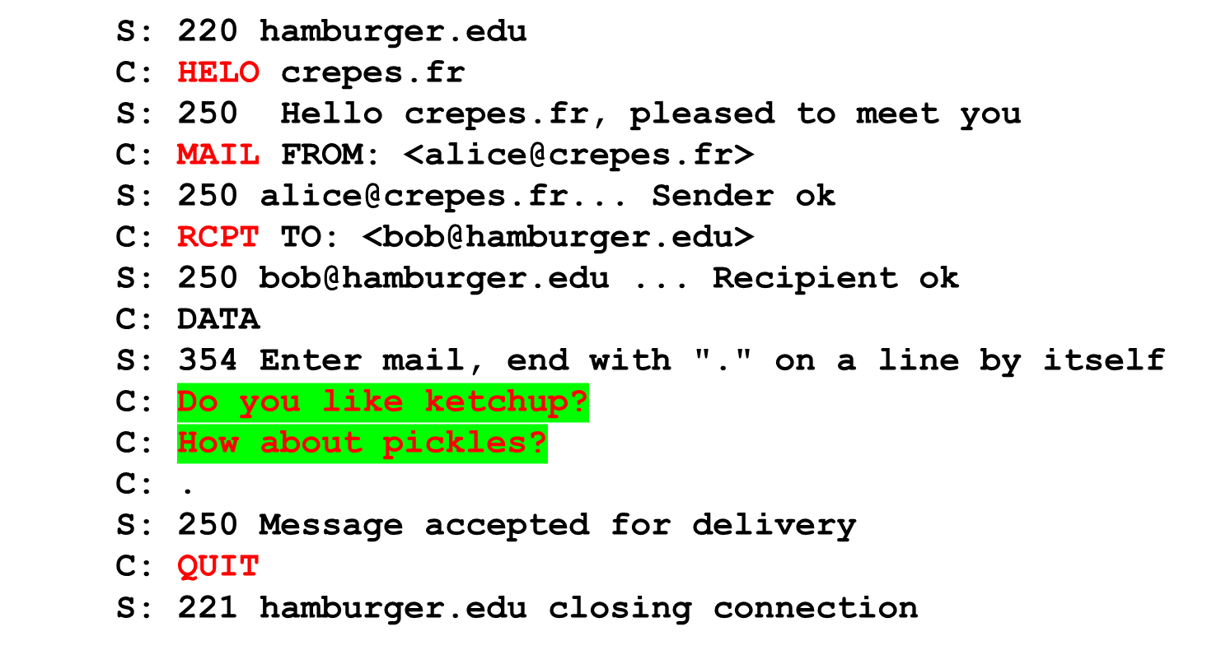
Sample SMTP interaction
An example transcript of messages exchanged between an SMTP client (C) and an SMTP server (S).
The hostname of the client is crepes.fr and the hostname of the server is hamburger.edu
BITS Pilani, Deemed to be University under Section 3 of UGC Act, 1956

Slide 13
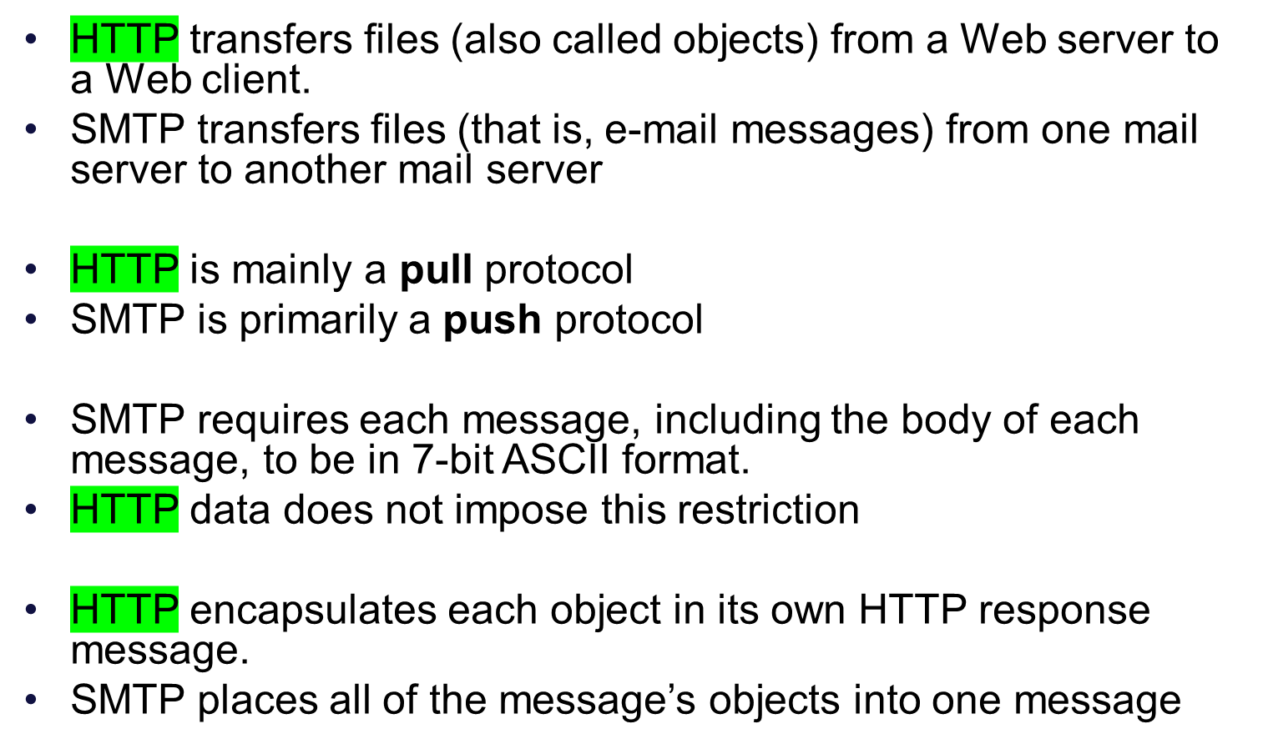
Sample SMTP interaction
BITS Pilani, Deemed to be University under Section 3 of UGC Act, 1956

Slide 14
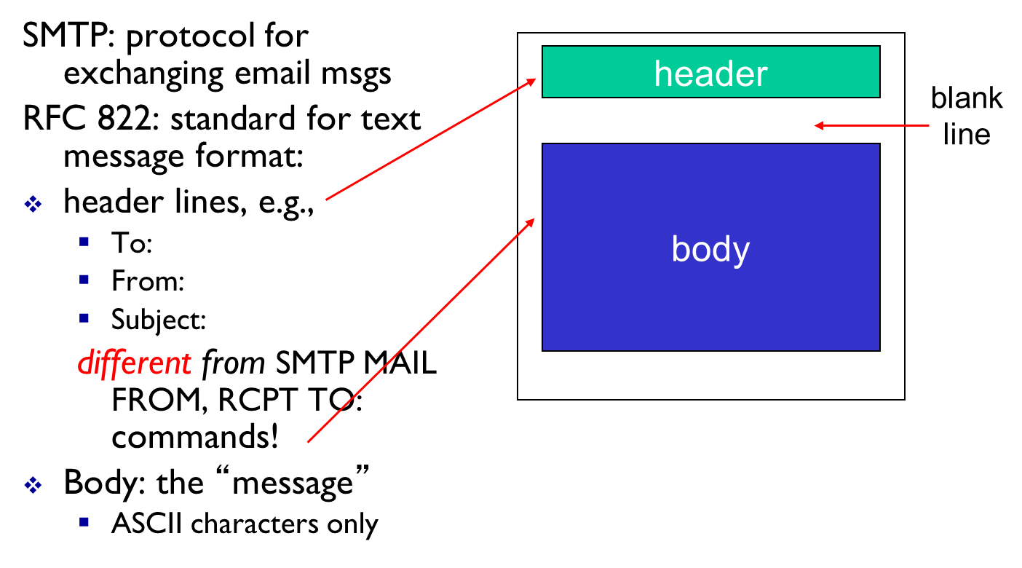
Mail message format
When an e-mail message is sent from one person to another, a header containing peripheral information precedes the body of the message itself
BITS Pilani, Deemed to be University under Section 3 of UGC Act, 1956

Slide 15
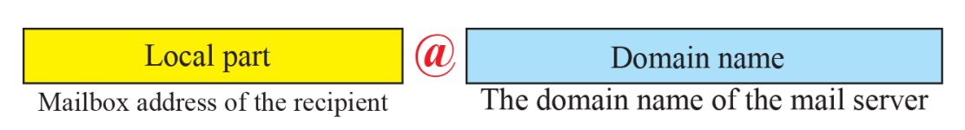
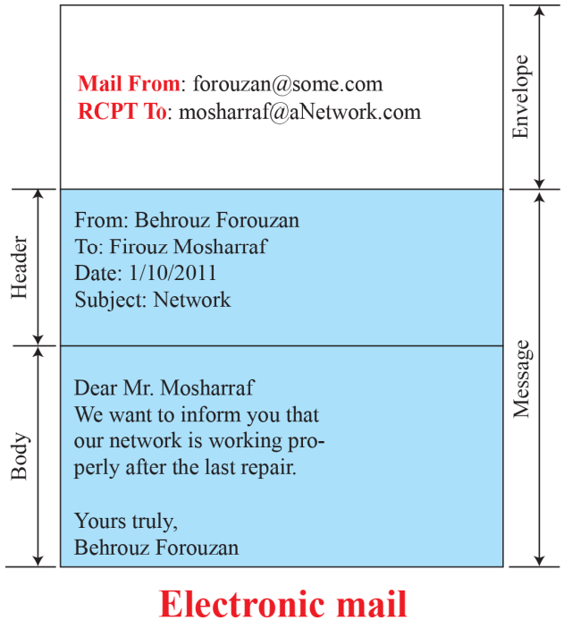
Mail message format
Each header line contains readable text, consisting of a keyword followed by a colon followed by a value.
Every header must have a From: header line and a To: header line; a header may include a Subject: header line as well as other optional header lines
BITS Pilani, Deemed to be University under Section 3 of UGC Act, 1956

Slide 16
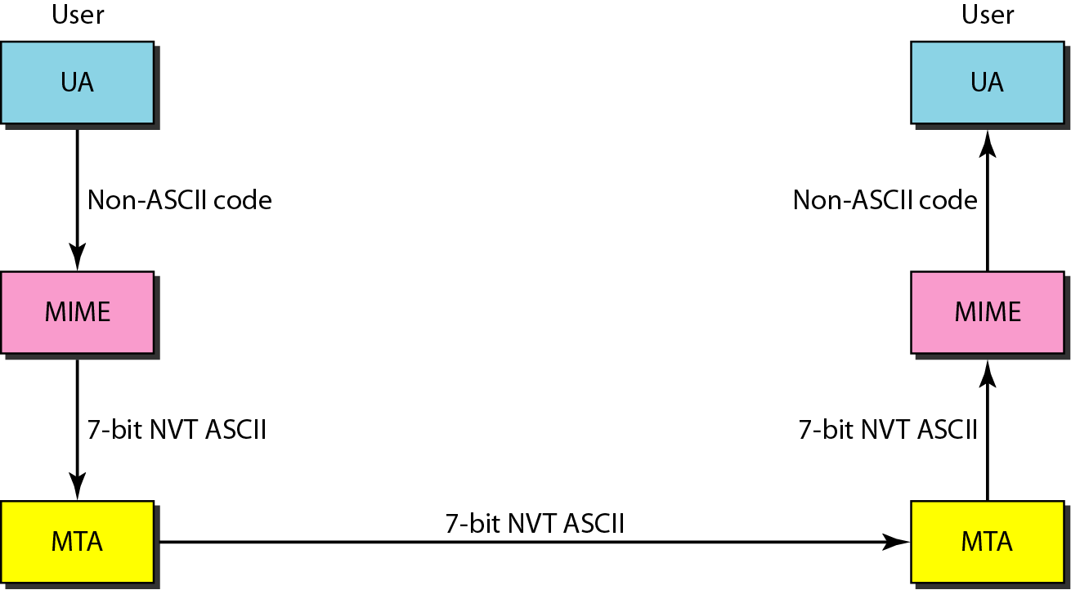
MIME
BITS Pilani, Deemed to be University under Section 3 of UGC Act, 1956

Slide 17
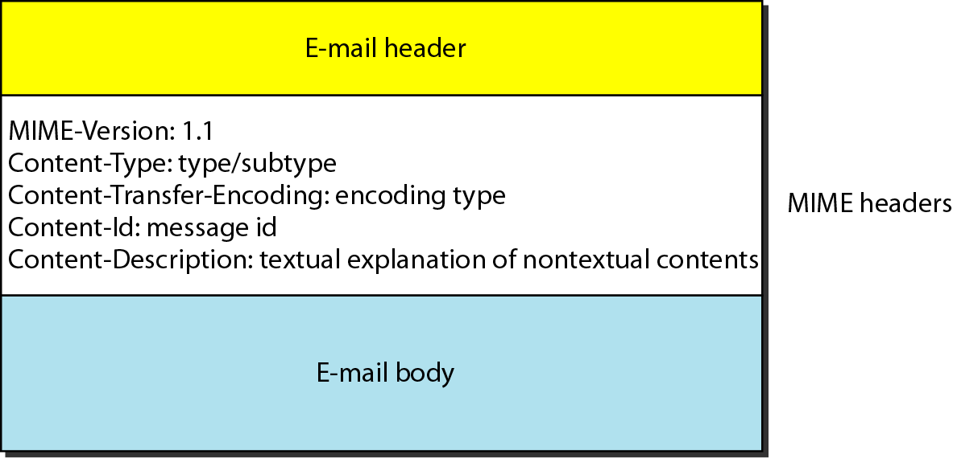
MIME header
BITS Pilani, Deemed to be University under Section 3 of UGC Act, 1956

Slide 18
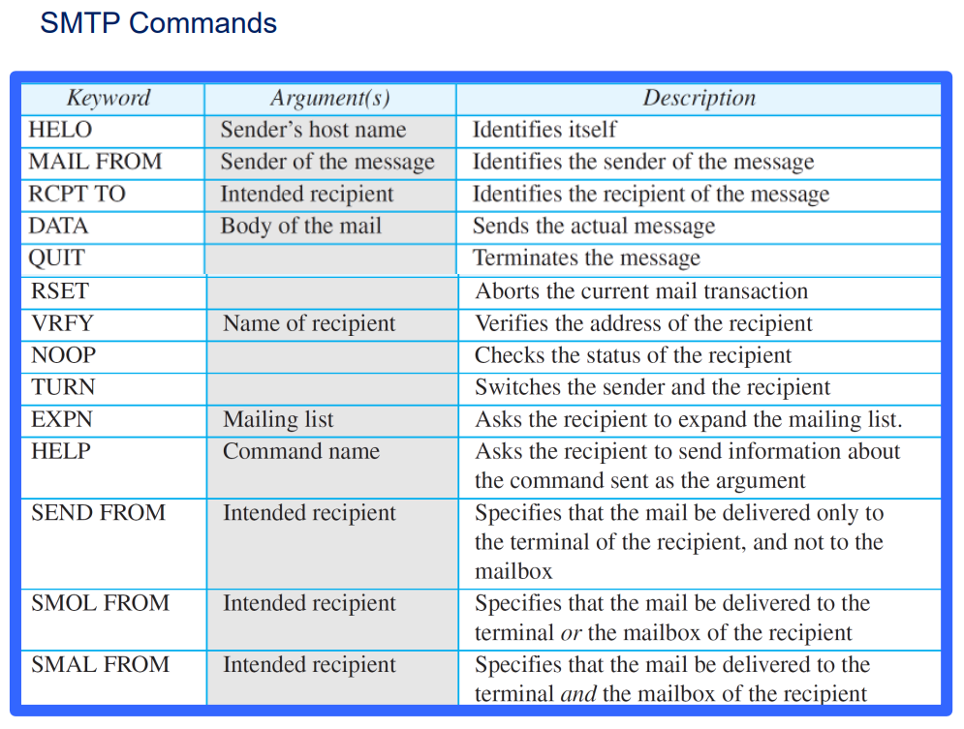
MIME header
BITS Pilani, Deemed to be University under Section 3 of UGC Act, 1956

Slide 19
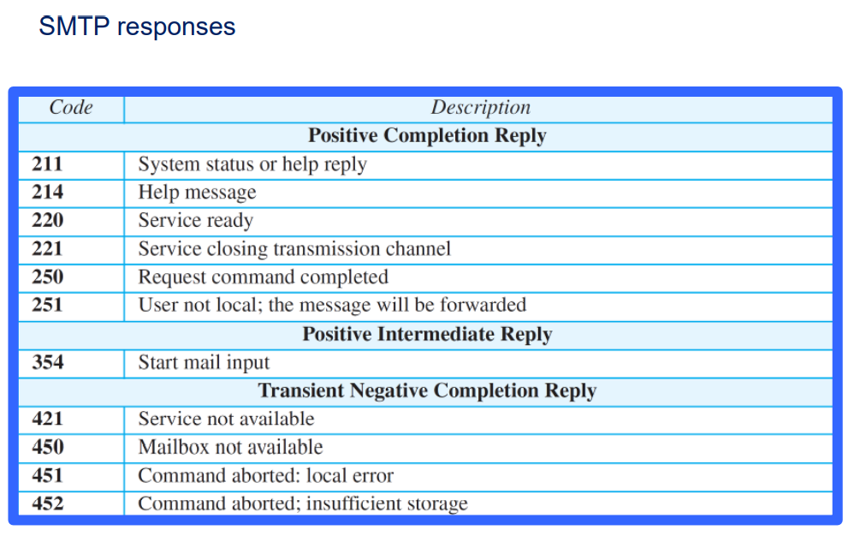
BITS Pilani, Deemed to be University under Section 3 of UGC Act, 1956

Slide 20
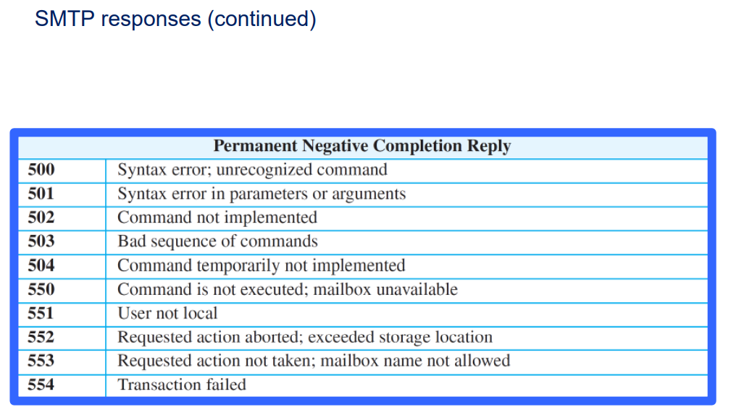
BITS Pilani, Deemed to be University under Section 3 of UGC Act, 1956

Slide 21
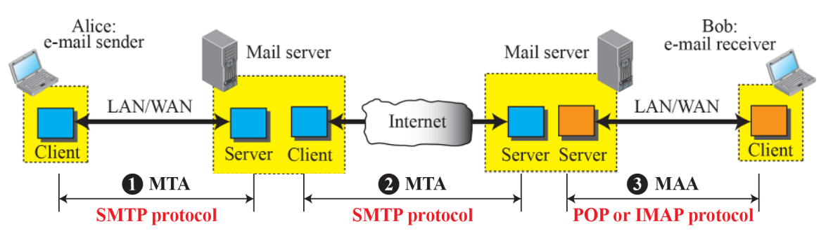
Mail access protocols
BITS Pilani, Deemed to be University under Section 3 of UGC Act, 1956

Slide 22
Mail message format
There are currently a number of popular mail access protocols, including Post Office Protocol—Version 3 (POP3), Internet Mail Access Protocol (IMAP)
POP: Post Office Protocol [RFC 1939]:
Protocol is so simple, and its functionality is limited
POP begins when the user agent (the client) opens a TCP connection to the mail server.
POP3 progresses through three phases: authorization, transaction, and update
  the user agent sends a username and a password (in the clear) to authenticate the user
  transaction, the user agent retrieves messages
  update, occurs after the client has issued the quit command
BITS Pilani, Deemed to be University under Section 3 of UGC Act, 1956

Slide 23
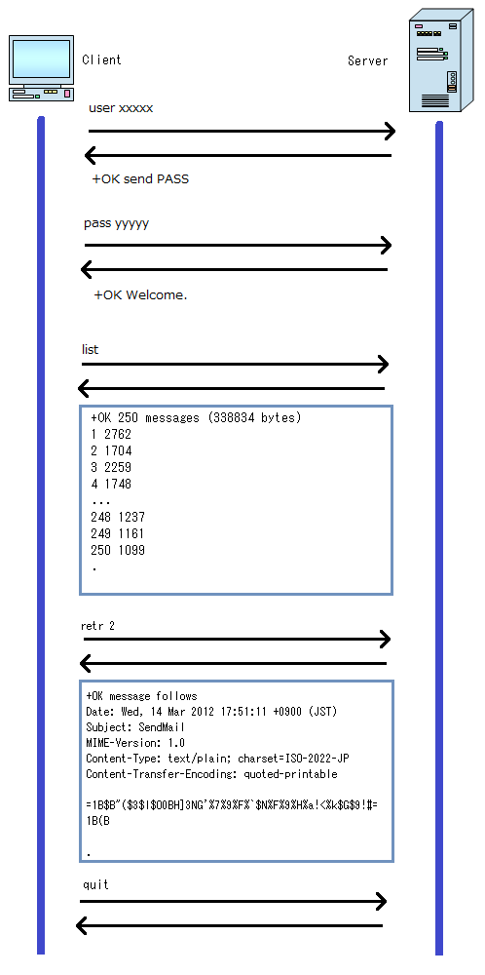
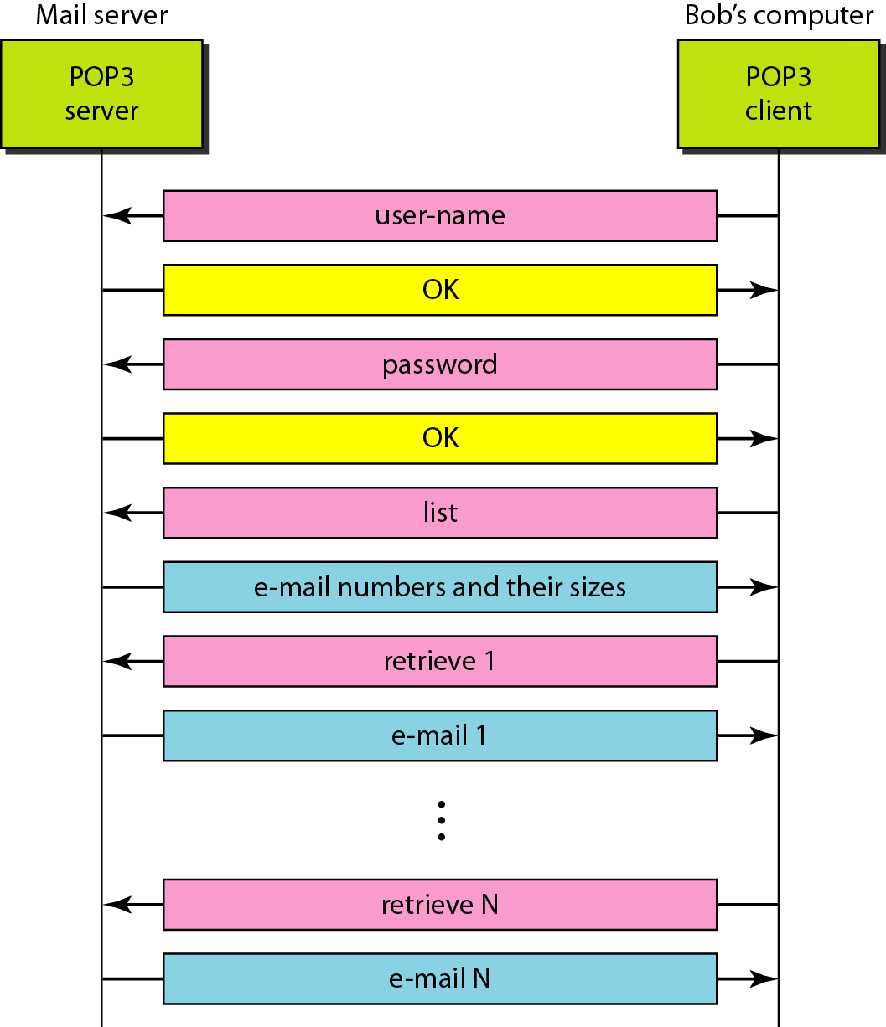
POP3 protocol
BITS Pilani, Deemed to be University under Section 3 of UGC Act, 1956

Slide 24
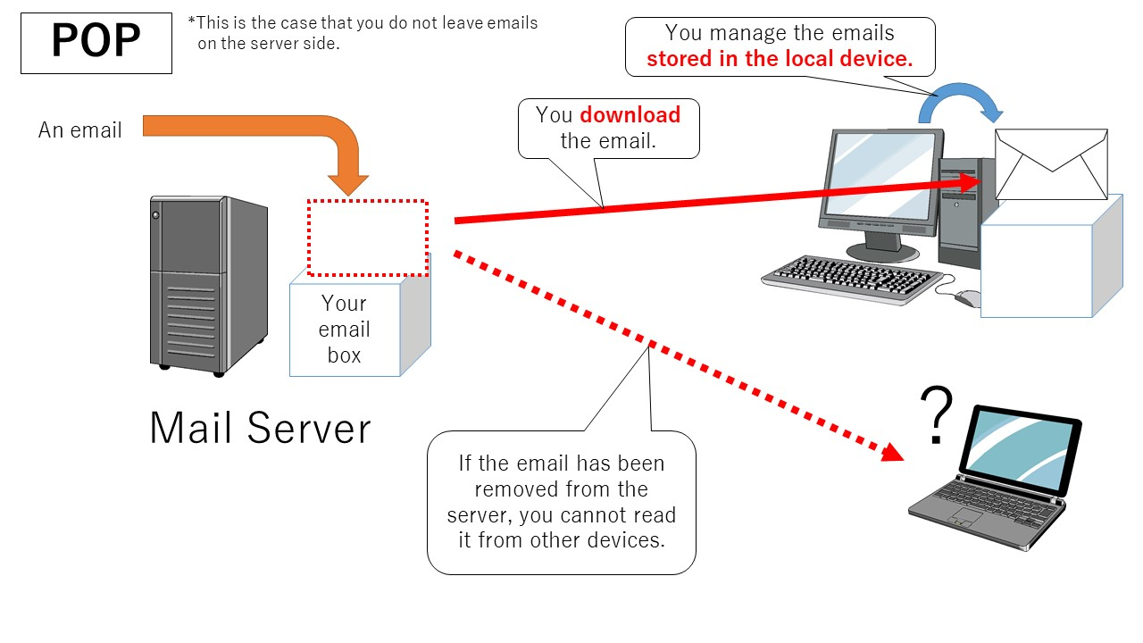
POP3 protocol
BITS Pilani, Deemed to be University under Section 3 of UGC Act, 1956

Slide 25
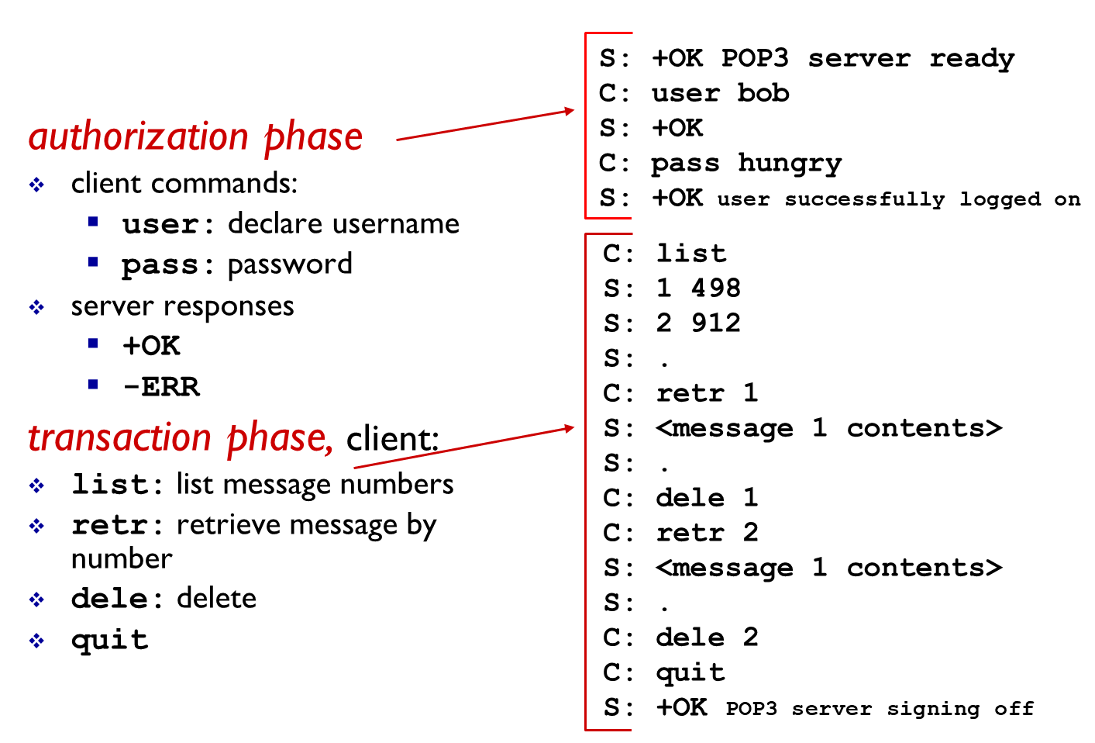
POP3 protocol
https://www.codeproject.com/Articles/404066/Understanding-the-Insides-of-the-POP3-Mail-Protoco
BITS Pilani, Deemed to be University under Section 3 of UGC Act, 1956

Slide 26
IMAP protocol
IMAP is a mail access protocol.
An IMAP server will associate each message with a folder; when a message first arrives at the server, it is associated with the recipient’s INBOX folder.
The recipient can then move the message into a new, user-created folder, read the message, delete the message, and so on.
The IMAP protocol provides commands to allow users to create folders and move messages from one folder to another.
IMAP also provides commands that allow users to search remote folders for messages matching specific criteria
IMAP permit a user agent to obtain components of messages.
For example, a user agent can obtain just the message header of a message or just one part of a multipart MIME message.
BITS Pilani, Deemed to be University under Section 3 of UGC Act, 1956

Slide 27
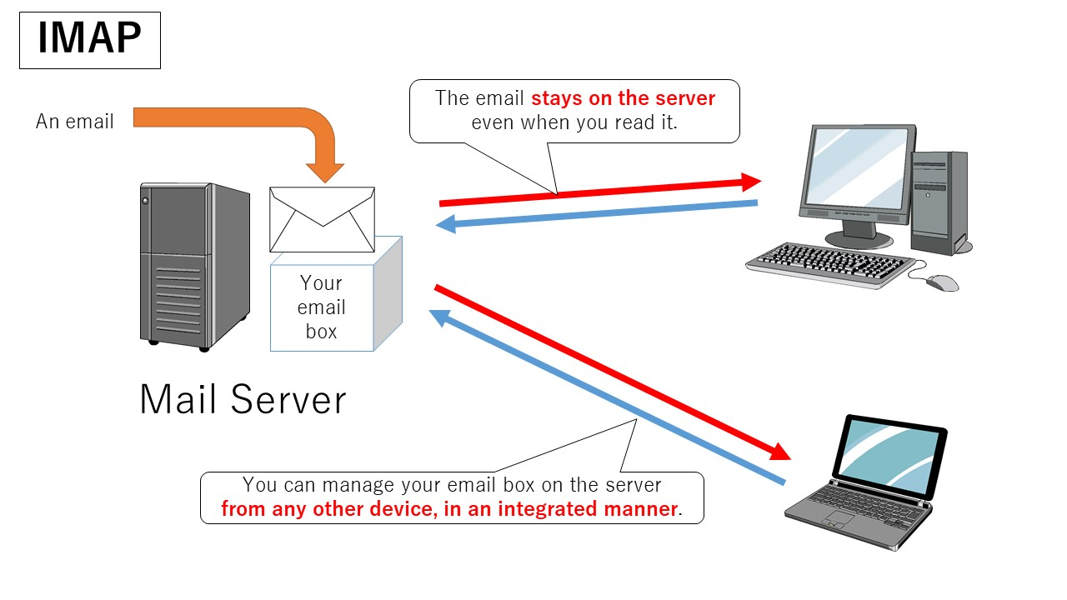
IMAP protocol
BITS Pilani, Deemed to be University under Section 3 of UGC Act, 1956

Slide 28
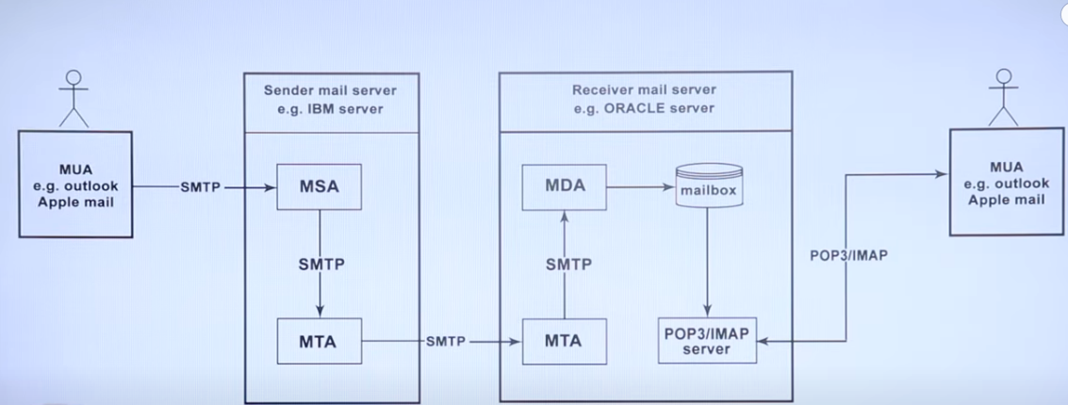
IMAP protocol
BITS Pilani, Deemed to be University under Section 3 of UGC Act, 1956

Slide 29
DNS: Domain Name System
Hosts in Internet are identified by a hostname
Hostnames → cnn.com, www.yahoo.com, gaia.cs.umass.edu, and cis.poly.edu
Hostnames also provide information (if any) about the location within the Internet of the host.
E.g.www.eurecom.fr →The host is probably in France
Hostnames can consist of variable length alphanumeric characters it would be difficult for the routers to process them
For these reasons, hosts are also identified by so-called IP addresses
BITS Pilani, Deemed to be University under Section 3 of UGC Act, 1956

Slide 30
Services Provided by DNS
Every hostname is associated with IP address
A directory service that translates hostnames to IP addresses → Main task of the Internet’s Domain Name System (DNS)
DNS is
  A distributed database implemented in a hierarchy of DNS servers
  An application-layer protocol that allows hosts to query the distributed database.
DNS is commonly employed by other application-layer protocols - including HTTP, SMTP, and FTP
BITS Pilani, Deemed to be University under Section 3 of UGC Act, 1956

Slide 31
Services Provided by DNS
Consider what happens when a browser (that is, an HTTP client), running on some user’s host, requests the URL www.someschool.edu/index.html
For the user’s host to be able to send an HTTP request message to the web server www.someschool.edu, the user’s host must first obtain the IP address of www.someschool.edu
  The same user machine runs the client side of the DNS application.
  The browser extracts the hostname, www.someschool.edu, from the URL and passes the hostname to the client side of the DNS application.
  The DNS client sends a query containing the hostname to a DNS server.
  The DNS client eventually receives a reply, which includes the IP address for the hostname.
  Once the browser receives the IP address from DNS, it can initiate a TCP connection to the HTTP server process located at port 80 at that IP address.
BITS Pilani, Deemed to be University under Section 3 of UGC Act, 1956

Slide 32

DNS: Domain Name System
BITS Pilani, Deemed to be University under Section 3 of UGC Act, 1956

Slide 33
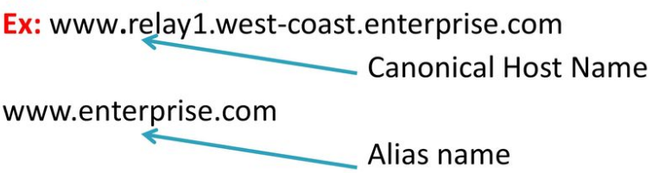
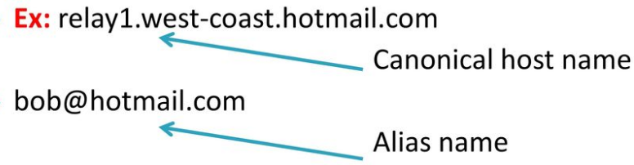
Services Provided by DNS
Host aliasing
  A host with a complicated hostname can have one or more alias names
  www. relay1.west-coast.enterprise.com could have, say, two aliases such as enterprise.com and www.enterprise.com
Mail server aliasing
  DNS can be invoked by a mail application to obtain the canonical hostname for a supplied alias hostname as well as the IP address of the host.
BITS Pilani, Deemed to be University under Section 3 of UGC Act, 1956

Slide 34
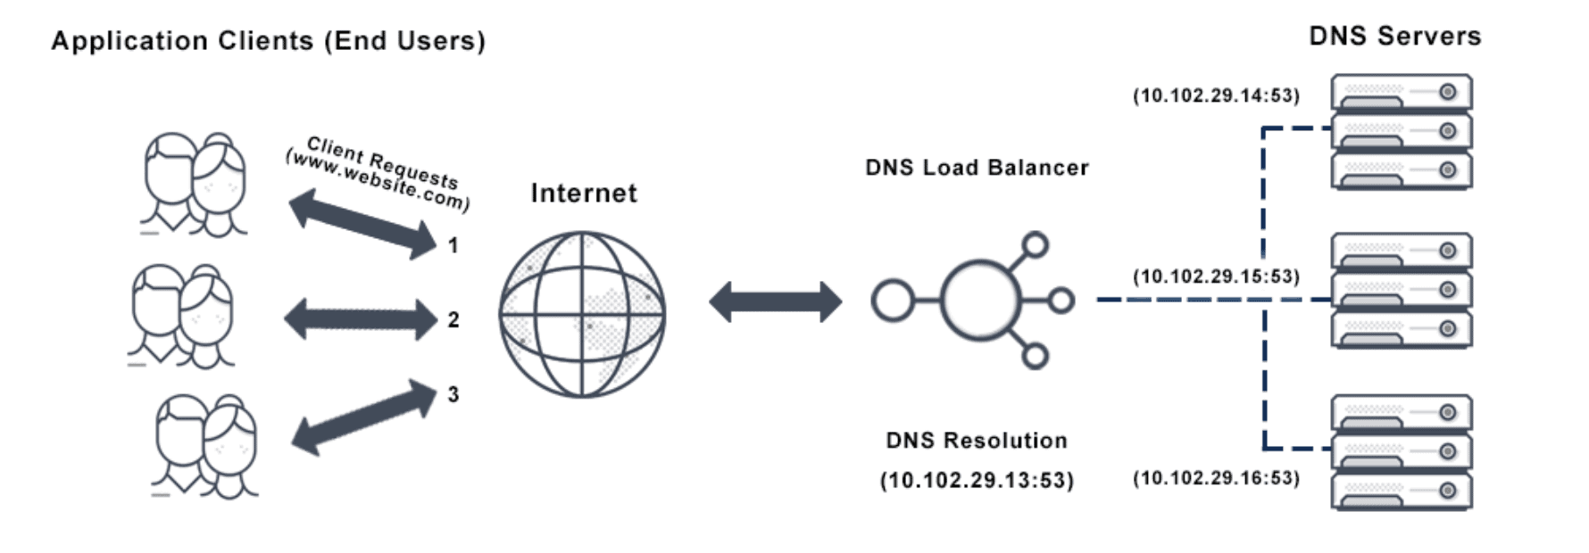
Services Provided by DNS
Load distribution
  DNS is also used to perform load distribution among replicated servers, such as replicated Web servers.
  Busy sites are replicated over multiple servers, with each server running on a different end system and each having a different IP address (amazon.com, irctc.co.in)
  For replicated Web servers, a set of
  IP addresses is thus associated with one canonical hostname.
  The DNS database contains this set of IP addresses. When clients make a DNS query for a name mapped to a set of addresses.
BITS Pilani, Deemed to be University under Section 3 of UGC Act, 1956

Slide 35
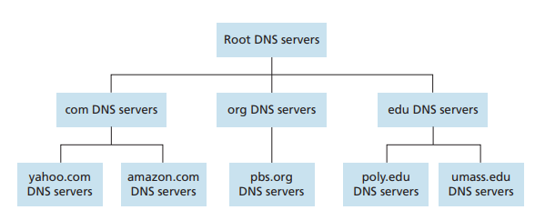
Overview of how DNS works?
A simple design for DNS would have one DNS server that contains all the mappings
Clients simply direct all queries to the single DNS server, and the DNS server responds directly to the querying clients.
A centralized database in a single DNS server simply doesn’t scale and hence the DNS is distributed by design.
BITS Pilani, Deemed to be University under Section 3 of UGC Act, 1956

Slide 36




Overview of how DNS works?
BITS Pilani, Deemed to be University under Section 3 of UGC Act, 1956

Slide 37
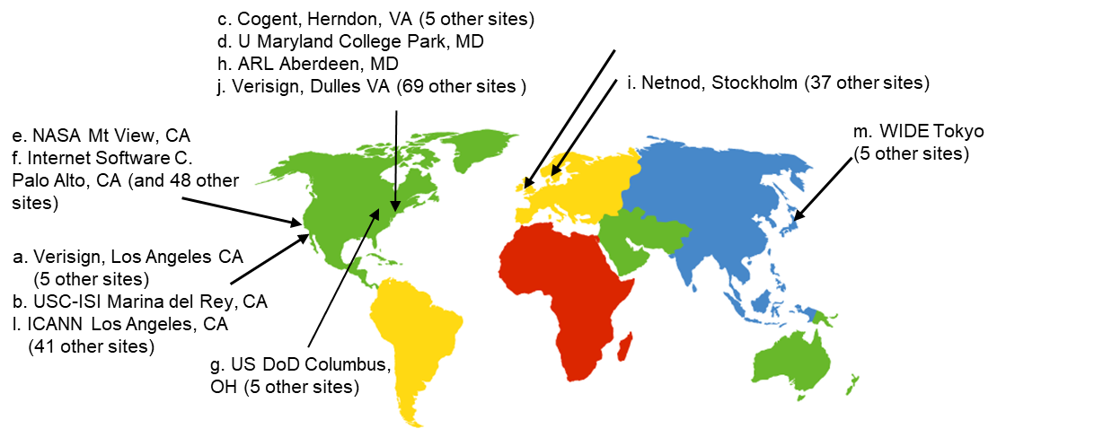
Overview of how DNS works?
The mappings are distributed across the DNS servers.
There are three classes of DNS servers
Root DNS servers
  contacts authoritative name server if name mapping not known
  gets mapping
  returns mapping to local name server
13 root name “servers” worldwide
BITS Pilani, Deemed to be University under Section 3 of UGC Act, 1956

Slide 38
Overview of how DNS works?
Top-level domain (TLD) DNS servers
  responsible for com, org, net, edu, aero, jobs, museums, and all top-level country domains, e.g.: uk, fr, ca, jp
  Network Solutions maintains servers for .com TLD
  Educause for .edu TLD
Authoritative DNS servers
  organization’s own DNS server(s), providing authoritative hostname to IP mappings for organization’s named hosts
  can be maintained by organization or service provider
BITS Pilani, Deemed to be University under Section 3 of UGC Act, 1956

Slide 39
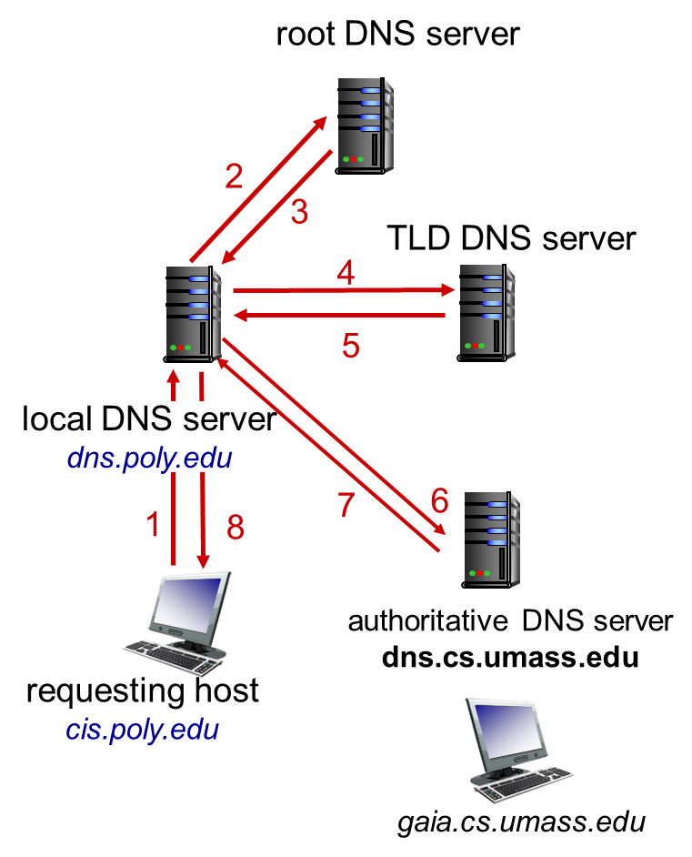
DNS Lookup Process
BITS Pilani, Deemed to be University under Section 3 of UGC Act, 1956

Slide 40
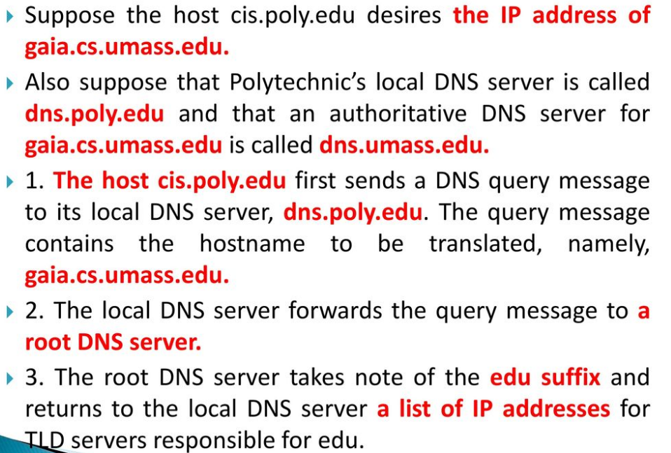
DNS Lookup Process
BITS Pilani, Deemed to be University under Section 3 of UGC Act, 1956

Slide 41
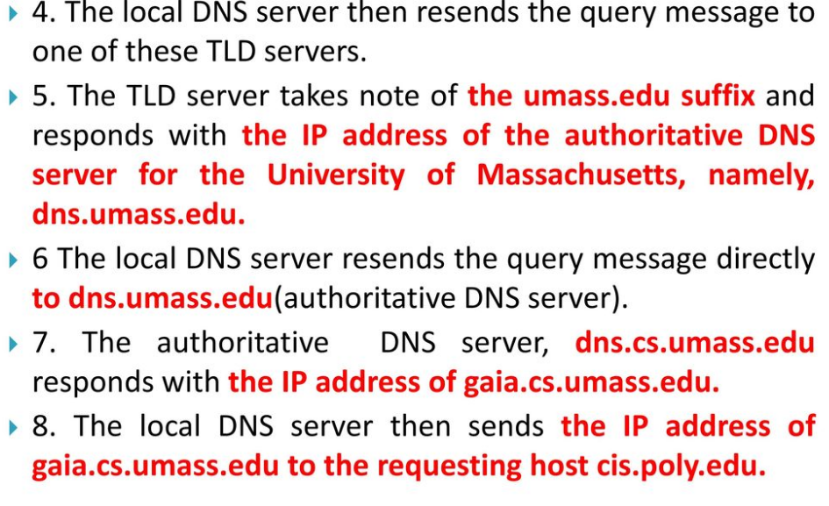
DNS Lookup Process
BITS Pilani, Deemed to be University under Section 3 of UGC Act, 1956

Slide 42
Local DNS name server
does not strictly belong to hierarchy
each ISP (residential ISP, company, university) has one
  also called “default name server”
when host makes DNS query, query is sent to its local DNS server
  has local cache of recent name-to-address translation pairs (but may be out of date!)
  acts as proxy, forwards query into hierarchy
BITS Pilani, Deemed to be University under Section 3 of UGC Act, 1956

Slide 43
DNS: caching, updating records
once (any) name server learns mapping, it caches mapping
  cache entries timeout (disappear) after some time (TTL)
  TLD servers typically cached in local name servers
    thus root name servers not often visited
cached entries may be out-of-date (best effort name-to-address translation!)
  if name host changes IP address, may not be known Internet-wide until all TTLs expire
BITS Pilani, Deemed to be University under Section 3 of UGC Act, 1956

Slide 44
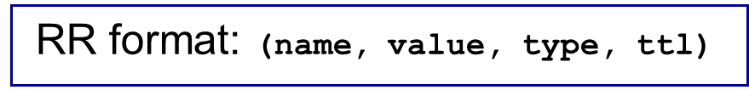
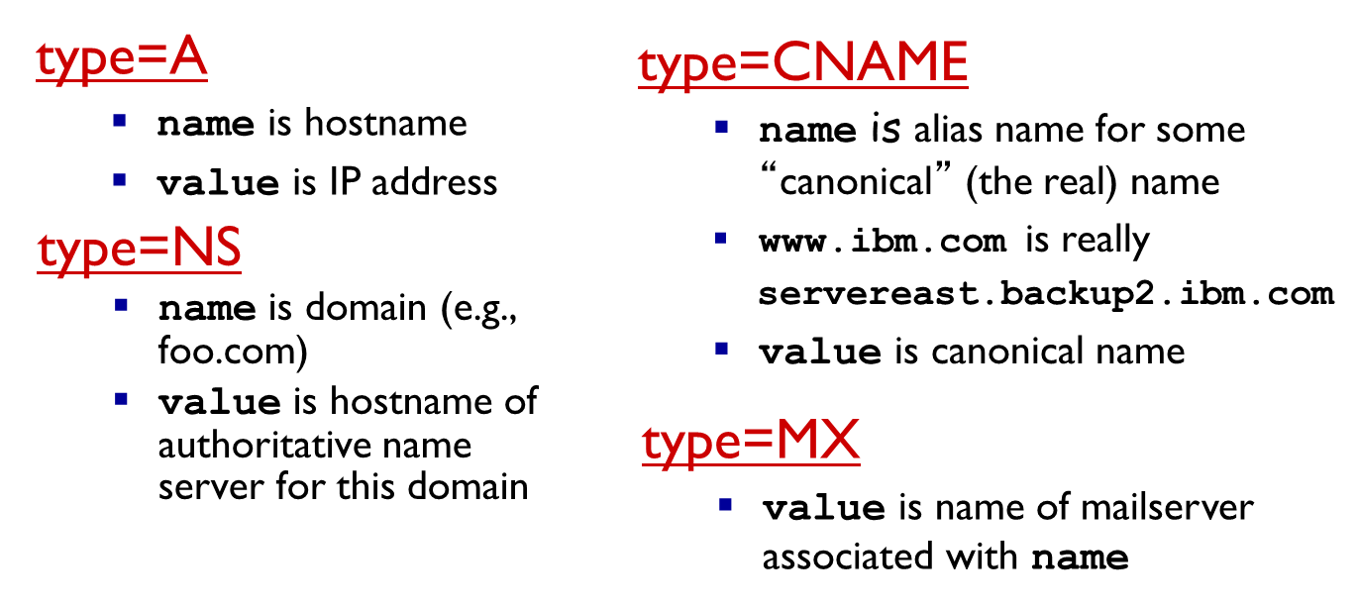
DNS records
DNS: distributed db storing resource records (RR)
BITS Pilani, Deemed to be University under Section 3 of UGC Act, 1956

Slide 45
DNS protocol, messages
query and reply messages, both with same message format
2 bytes
2 bytes
msg header
identification: 16 bit # for query, reply to query uses same #
flags:
  query or reply
  recursion desired
  recursion available
  reply is authoritative
identification
flags
# questions
# answer RRs
# authority RRs
# additional RRs
questions (variable # of questions)
answers (variable # of RRs)
authority (variable # of RRs)
additional info (variable # of RRs)

Slide 46
DNS protocol, messages
2 bytes
2 bytes
identification
flags
# questions
# answer RRs
# authority RRs
# additional RRs
name, type fields
for a query
questions (variable # of questions)
RRs in response
to query
answers (variable # of RRs)
records for
authoritative servers
authority (variable # of RRs)
additional “helpful”
info that may be used
additional info (variable # of RRs)

Slide 47
Inserting records into DNS
example: new startup “Network Utopia”
register name networkuptopia.com at DNS registrar (e.g., Network Solutions)
  provide names, IP addresses of authoritative name server (primary and secondary)
  registrar inserts two RRs into .com TLD server:
  (networkutopia.com, dns1.networkutopia.com, NS) (dns1.networkutopia.com, 212.212.212.1, A)
create authoritative server type A record for www.networkuptopia.com; type MX record for networkutopia.com
BITS Pilani, Deemed to be University under Section 3 of UGC Act, 1956

Slide 48
Attacking DNS
DDoS attacks
Bombard root servers with traffic
  Not successful to date
  Traffic Filtering
  Local DNS servers cache IPs of TLD servers, allowing root server bypass
Bombard TLD servers
  Potentially more dangerous
Redirect attacks
Man-in-middle
  Intercept queries
DNS poisoning
  Send bogus relies to DNS server, which caches
Exploit DNS for DDoS
Send queries with spoofed source address: target IP
Requires amplification
BITS Pilani, Deemed to be University under Section 3 of UGC Act, 1956

Slide 49
Thank You!

